Slide 1


Anjali Walisinghe
24 July 2024

Slide 2

Outline
Executive Summary (slide 3)
Introduction (slide 4)
Section 1: Methodology (slides 5-15)
Section 2: Insights drawn from EDA (slides 16-32)
Section 3: Launch Sites Proximities Analysis (slides 33-36)
Section 4: Build a Dashboard with Plotly Dash (slides 37-40)
Section 5: Predictive Analysis (Classification) (slides 41-43)
Conclusion (slide 44)
Appendix (slide 45)

Slide 3
Executive Summary
Project: Maximizing cost savings for SpaceY through Falcon 9 rocket launches
Methodology:
Collection of SpaceX launch data from SpaceX and related Wiki sites
Exploratory data analysis (EDA) and data visualization of SpaceX launch features, including rocket, launch site and landing features
Predictive model exploration, testing and training to determine the best classification model to predict successful rocket launches
Results:
Data collection and exploratory analysis allowed identification of rocket launch features of interest

Slide 4
Introduction
Background
SpaceY recognizes the exciting new opportunities available with commercial innovations in space travel
Competing with existing players in the market means understanding all aspects of space flight to provide the best and safest experience without an exorbitant price tag
Existing commercial space flight providers have already tested and documented space flight with various different rockets and launchers
Problems
What equipment/work is needed to achieve space flight?
Where can SpaceY minimize cost without impacting on space flight safety?

Slide 5

Section 1

Slide 6
Methodology
Executive Summary
Data sources
Data collection methodology
Data Wrangling
Exploratory data analysis (EDA) and data visualization
Interactive visual analytics
Predictive analysis using classification models

Slide 7
Data Collection – Data Sources
Data used was obtained from SpaceX’s website via the SpaceX REST API (URL https://api.spacexdata.com/v4)
SpaceX data obtained related to rocket booster name, launch site (including geographical coordinates), payload mass, orbit and launch outcomes
Additional data was also obtained through scraping of a related Wikipedia page, “List of Falcon 9 and Falcon Heavy launches” (URL https://en.wikipedia.org/wiki/List_of_Falcon_9_and_Falcon_Heavy_launches)
Launch data located in a HTML table on the page was used, which included data on flight date and time, rocket booster used, launch site, payload, orbit, customer and launch outcome
SpaceX launches were isolated from the Wikipedia page for this analysis

Slide 8
Data Collection – SpaceX API Flowchart
Define API extraction helper functions
Illustrated is the process for collecting and cleaning SpaceX Falcon 9 launch data.
The full Python notebook detailing libraries used, API request, data parsing and wrangling methods can be found here
Request rocket launch data from SpaceX API
Parse data for input into Pandas dataframe
Filter data to include only Falcon 9 launches
Data wrangling and export to CSV file

Slide 9
Data Collection – Scraping Flowchart
Request Falcon 9 launches Wikipedia page using URL
Illustrated is the process for scraping and transforming data on historical Falcon 9 launches
The full Python notebook containing libraries and functions used, data scraping and parsing methods can be found here
Parse HTML using BeautifulSoup
Extract variable names from table column headers
Parse launch HTML tables to create data frame

Slide 10
Data Wrangling Flowchart
Once the SpaceX data CSV file was imported, data was examined to determine data types and missing values (including proportion of missing values) for all variables.
Counts were calculated for each launch site location, orbit type and mission outcome.
Landing outcomes were classified based on whether they were successful or unsuccessful
The full Python notebook with all data wrangling steps can be found here
Import saved SpaceX data
Data cleaning and analysis to determine data characteristics
Summary statistics on relevant variables
Created landing outcome classification variable

Slide 11
EDA and Data Visualization
Exploratory Data Analysis (EDA) conducted and data visualizations created to get insight into relationships between key variables and prepare for feature engineering (Python notebook here)
Visualizations:
Launch outcomes by flight number and payload mass: how does payload mass affect launch success over time?
Launch outcomes by flight number and launch site: how did launch success change over time at each site?
Launch outcomes by payload mass and launch site: what payload masses were launched at each site, and how did likelihood of launch success change at different payloads for each site?
Success rate by orbit type: Which orbits had the highest launch success rate?
Launch outcomes by orbit: how does launch success change over time for each orbit type?
Launch outcomes by payload mass and orbit type: how does payload mass affect launch successes for each orbit type?
How did launch successes change over time?
Feature Engineering:
Determine relevant features for predictive modelling based on visualizations
Create dummy variables for categorical variables (One Hot Encoding)
Change numeric columns to float (float64)

Slide 12
EDA with SQL
SQL queries were written using SQL magic in Python
Data exploration included searching for launch site names, calculating payload mass totals for different launch scenarios and summarizing landing outcomes
Queries were also used to select specific records, to examine data features at a glance
The full Python notebook can be found here

Slide 13
Interactive Visual Analytics: Folium Maps
Interactive maps of all launch sites were developed with Folium
Circles and text labels were used to mark each site with its name
Additional markers were added to display launch outcomes at each site, colour coordinated to indicate successful (green) or failed (red) landings
To illustrate the relative proximity of one site (VAFB) to its surroundings, line markers were added with distance calculations to show the nearest natural and man-made land features
The full Python notebook can be viewed here (Python notebook is stored here but maps cannot be rendered)

Slide 14
Interactive Visual Analytics: Plotly Dash
Plotly Dash was used to build a dashboard illustrating landing outcomes by launch site
A pie chart calculated the proportion of successful landings by launch site, with a further drill-down to illustrate the proportion of successful and failed landings at each site
A scatter chart illustrated trends in launch outcomes by payload mass and booster version, which could be filtered via a payload mass slider to isolate trends for different ranges
The Plotly Dash app code can be viewed here

Slide 15
Predictive Analysis (Classification)
SpaceX data was used to develop training and test datasets to train four types of classification models: Logistic Regression, Support Vector Machines (SVM), Decision Trees and K-Nearest Neighbors (KNN)
Hyperparameter tuning was conducted to determine the most accurate parameters for each model
Accuracy scores and confusion matrices were calculated for all trained models after testing with test data, to determine the best model type for predicting launch outcomes
The full Python notebook can be found here
Import testing and training data
Process and standardize training data
Split training and test data
Conduct model estimator hyperparameter tuning
Apply selected parameters to train model
Calculate model accuracy on test data

Slide 16

Section 2

Slide 17
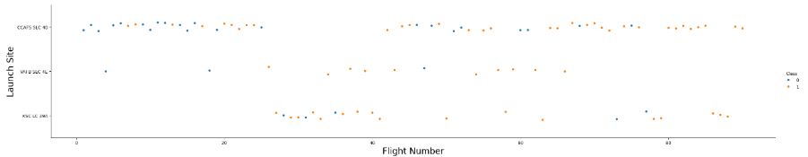
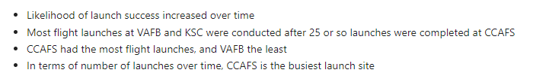
Flight Number vs. Launch Site

Slide 18
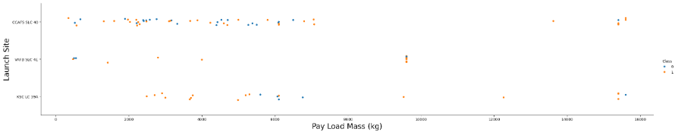
Payload vs. Launch Site

Slide 19
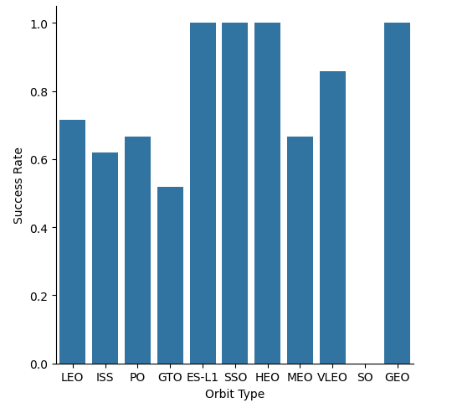
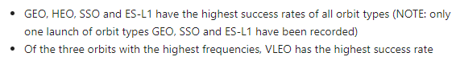
Success Rate vs. Orbit Type

Slide 20
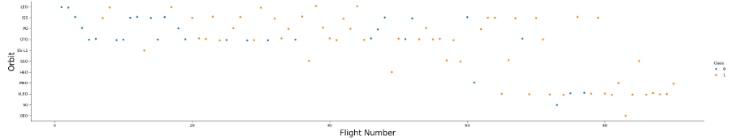
Flight Number vs. Orbit Type

Slide 21
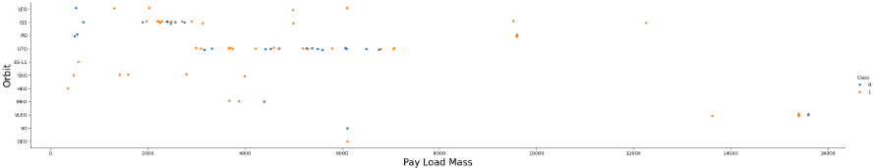
Payload vs. Orbit Type

Slide 22
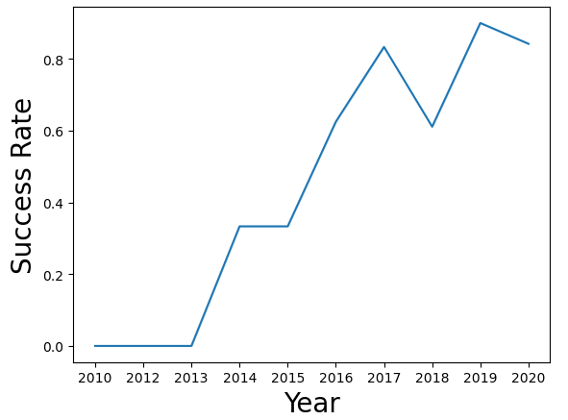
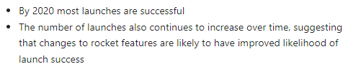
Launch Success Yearly Trend

Slide 23
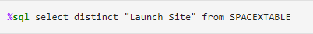
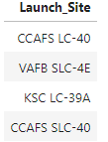
All Launch Site Names
The above code requests the unique launch site names from SPACEXTABLE, the dataset created in the SQL database containing the SpaceX Falcon 9 launch data
The code returned the four sites, including the two launch sites located at CCAFS

Slide 24
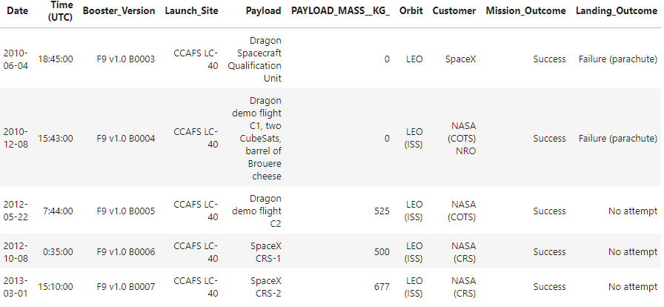
Launch Site Names Begin with 'CCA'
The above code requests 5 records from sites beginning with ‘CCA’, to bring 5 records from SPACEXTABLE on rockets launched at CCAFS (useful for getting a quick glimpse of the data)
The 5 records returned show no successful landing outcome for the launches

Slide 25
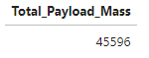
Total Payload Mass
The above code calculates the total payload mass across all records in SPACEXTABLE for Falcon rockets launched by NASA (CRS)
The payload mass variable was converted to a numeric variable for the calculation

Slide 26
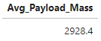
Average Payload Mass by F9 v1.1
The above calculates the average payload mass carried across all Falcon F9 launches with booster version 1.1
The payload mass variable was converted to a numeric format for calculation
The average payload mass across all launches was just under 3000 kg

Slide 27
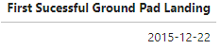
First Successful Ground Landing Date
%sql select min(Date) as "First Sucessful Ground Pad Landing" from SPACEXTABLE where "Landing_Outcome"='Success (ground pad)'
The above code selects the record with the earliest landing date out of all records of successful drone ship landings where payload mass carried was between 4000-6000 kg
The payload mass variable was converted to numeric for records selection
The first launch to result in a successful Ground Pad landing was conducted at the end of 2015

Slide 28
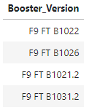
Successful Drone Ship Landing with Payload between 4000 and 6000
%sql select distinct "Booster_Version" from SPACEXTABLE
where "Landing_Outcome"='Success (drone ship)' and cast("PAYLOAD_MASS__KG_" as numeric) between 4000 and 6000
The above code brings the names of the boosters used for Falcon launches with a successful drone ship landing, carrying between 4000-6000kg payloads
The payload mass variable was converted to numeric for records selection
Only four booster versions were associated with successful drone ship landings for the above payload range

Slide 29
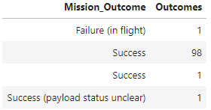
Total Number of Successful and Failure Mission Outcomes
The above code counts all Falcon 9 launches in the dataset and categorizes them by their outcome.
Dates were counted as each date corresponds to a record of a launch
Most mission outcomes were successful, however the payload status of one successful launch could not be determined
The above findings illustrate a possible data cleaning requirement for Mission_Outcome

Slide 30
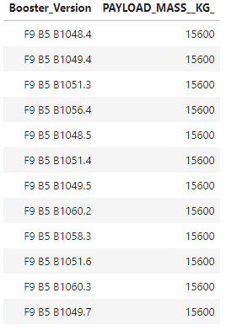
Boosters Carried Maximum Payload
%sql select distinct "Booster_Version", "PAYLOAD_MASS__KG_" from SPACEXTABLE where "PAYLOAD_MASS__KG_" =
select max(cast("PAYLOAD_MASS__KG_" as numeric)) from SPACEXTABLE)
The above code selects the Falcon booster versions from all launch records that have carried the largest recorded payload
A subquery was used to determine the maximum payload mass launched
12 booster types have been used for launches with the maximum payload mass recorded

Slide 31
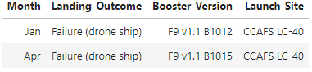
2015 Launch Records
This code selects records showing the month, booster version and launch site for failed drone ship launches in 2015
Substr() was used to isolate the months from the launch date variable (returned month as a number from 01 to 12)
All month numbers were changed to names for the printed table
Two launches in 2015 were failed drone ship landings
%sql select case substr(Date, 6,2)
when '01' then 'Jan’
when '02' then 'Feb’
when '03' then 'Mar’
when '04' then 'Apr’
when '05' then 'May’
when '06' then 'Jun’
when '07' then 'Jul’
when '08' then 'Aug’
when '09' then 'Sep’
when '10' then 'Oct’
when '11' then 'Nov’
when '12' then 'Dec’
else substr(Date, 6,2) end as "Month", "Landing_Outcome", "Booster_Version", "Launch_Site" from SPACEXTABLE
where "Landing_Outcome"='Failure (drone ship)' and substr(Date,0,5)='2015'

Slide 32
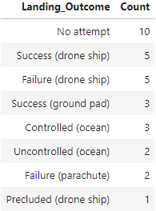
Rank Landing Outcomes Between 2010-06-04 and 2017-03-20
%sql select "Landing_Outcome", count(distinct Date) as "Count" from SPACEXTABLE
where Date between '2010-06-04' and '2017-03-20' group by "Landing_Outcome" order by count(distinct Date) desc
The above code counts all landing outcomes for Falcon 9 rockets launched between 6 April 2010 and 20 March 2017, by launch outcome
Results were ranked in descending order by the number of launches per outcome
Most landings were not attempted, and drone ships had the most successful landings

Slide 33

Section 3

Slide 34
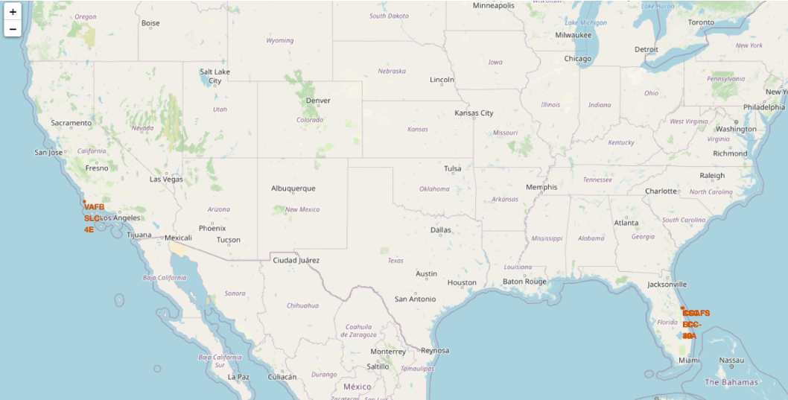
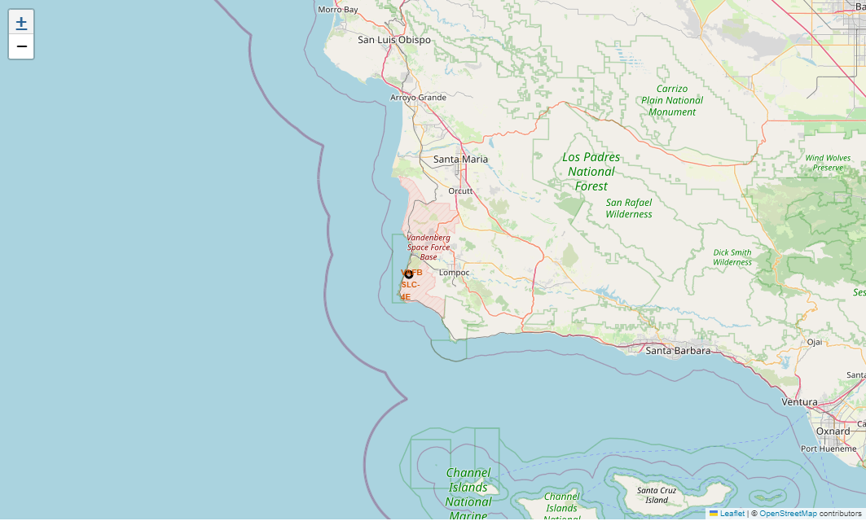
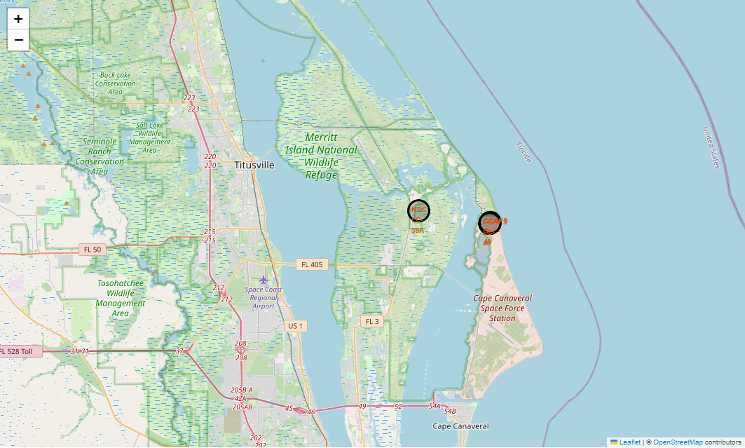
Falcon 9 Launch Sites Map
The above map shows all four Falcon 9 launch site locations in the United States
The maps to the left show the location of the VAFB (top), KSC and CCAFS sites (bottom)
Three out of four launch sites are located on the east coast
KSC is located inside Merritt Island National Wildlife Refuge, while the others are located on space force stations

Slide 35
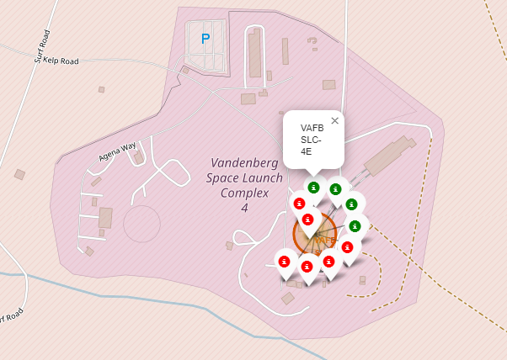
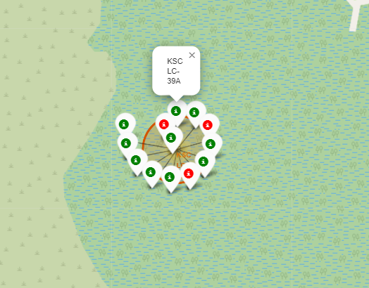
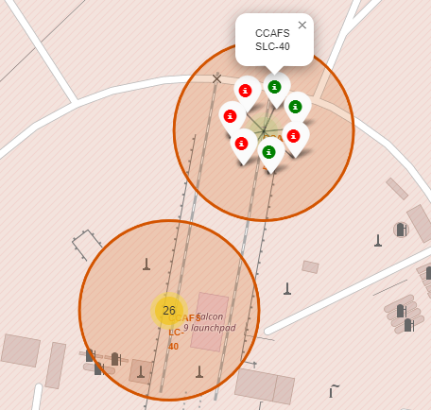
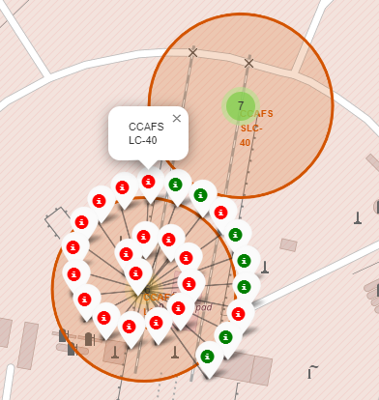
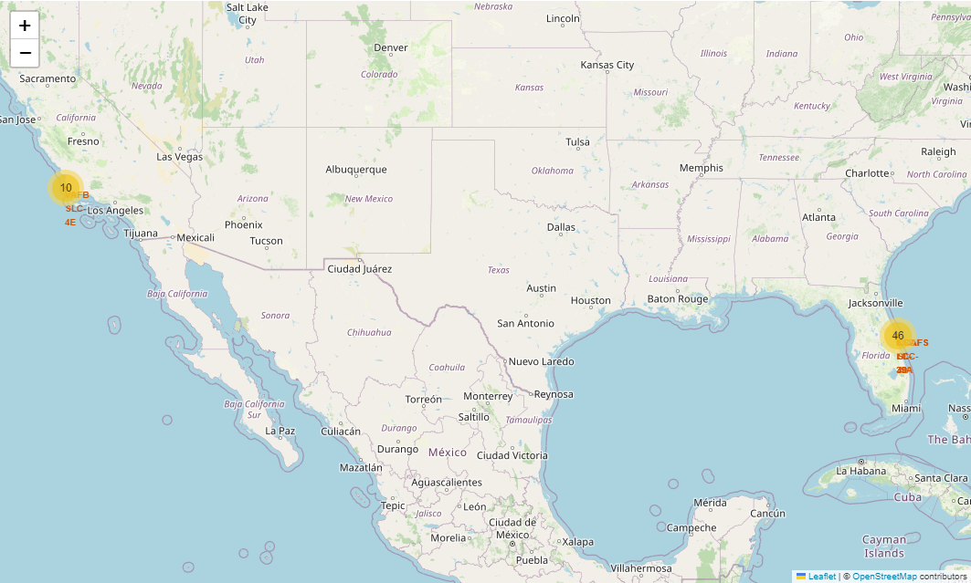
Falcon 9 Launch Sites Landing Outcomes Map
The above maps show the successful and failed Falcon 9 landings for VAFB (left), KSC (second from left) and CCAFS (second from right and right)
KSC had the most successful launches
CCAFS LC-40 had a high number of unsuccessful launches compared to CCAFS-SLC-40
All launch sites except KSC had more unsuccessful launches than successful ones

Slide 36
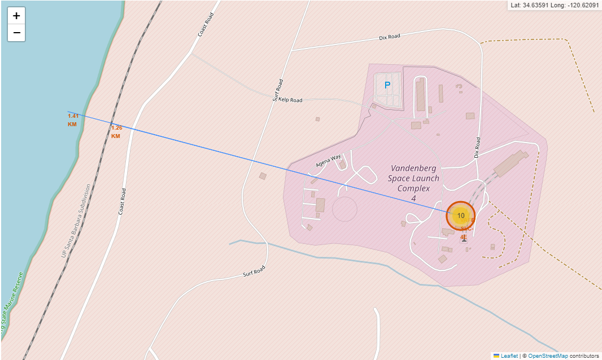
Launch Site Proximity Analysis: VAFB
VAFB is located near the California coast, north of Los Angeles
It is in a relatively isolated area surrounded by nature reserves and national parks
The nearest natural feature to VAFB is the Vandenberg State Marine Reserve, approximately 1.4km west of the site
The nearest railway line is the UP Santa Barbara Subdivision, approximately 1.25km west of the site

Slide 37

Section 4

Slide 38
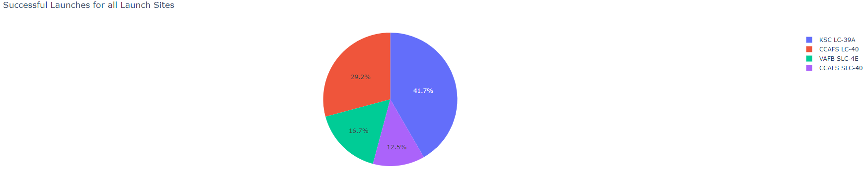
SpaceX Successful Launches for All Sites
The above chart shows the proportion of successful launches completed at each site
KSC accounted for the most successful launches out of all sites at almost 42%
CCAFS SLC-40 accounted for the least successful launches
CCAFS LC-40 accounted for a much larger portion of successful launches compared to CCAFS SLC-40

Slide 39
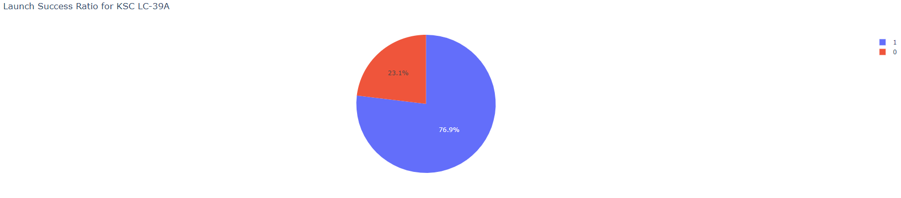
SpaceX Launch Success Ratio for KSC LC-39A
More than 75% of launches at KSC were successful
KSC also recorded the least number of unsuccessful launches

Slide 40
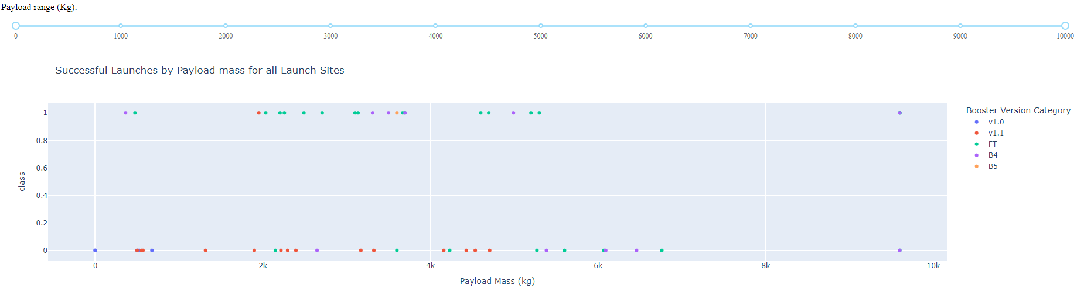
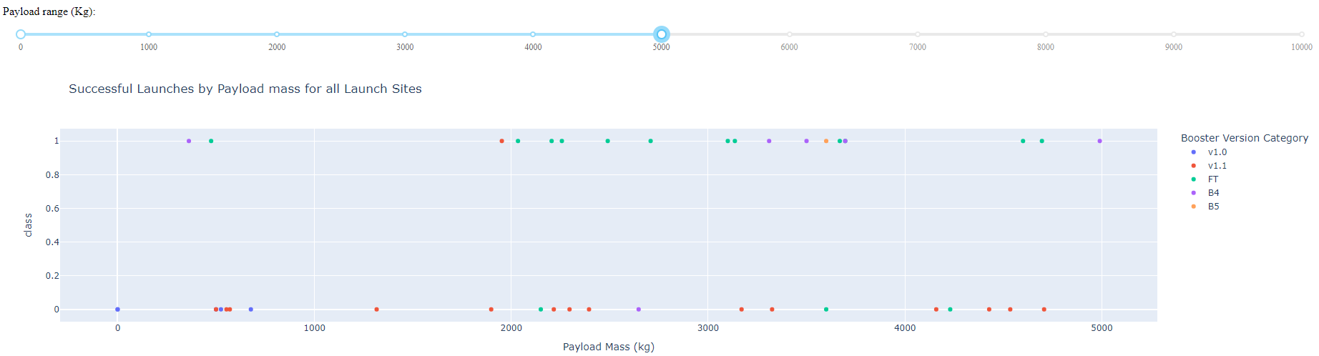
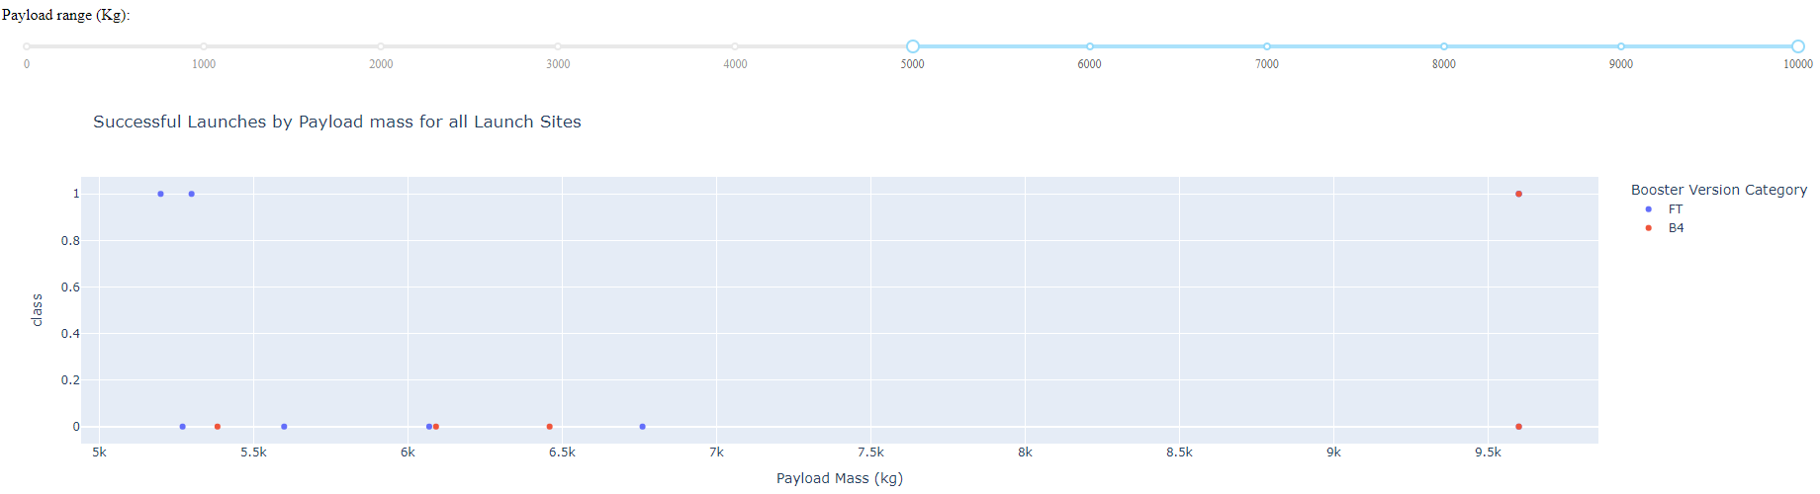
Successful Launches by Payload: All Launch Sites
Displayed is a comparison of successful launches at all launch sites for all payloads (top) for deployed payloads between 0-5000 (middle) and 5000-10000 (bottom), by booster version
V1.1 has the highest number of unsuccessful launches at all payload weights, FT has the highest number of successful launches
Most successful launches had payloads between 0 and 5000 kg.

Slide 41

Section 5

Slide 42
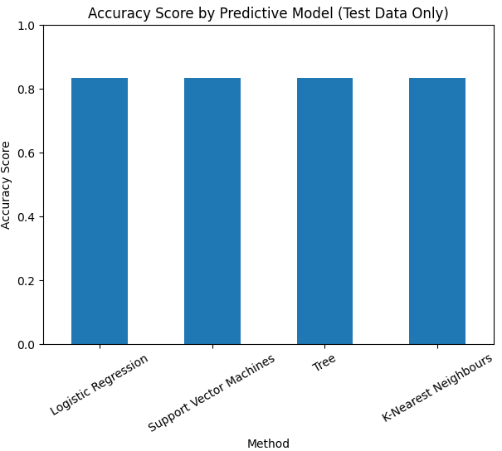
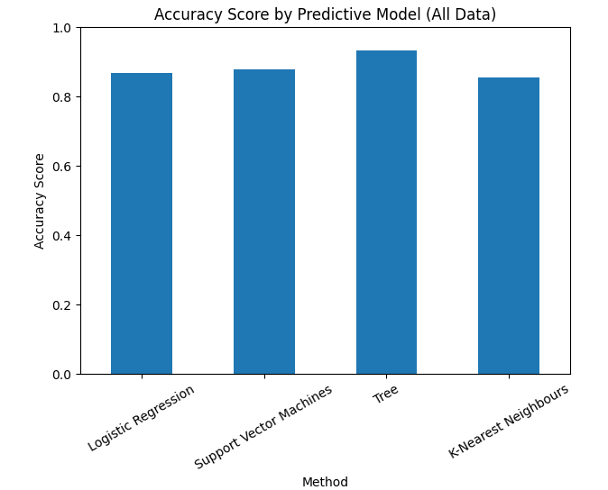
Classification Accuracy
Four predictive classification models were trained using SpaceX data: Logistic Regression, Support Vector Machines (SVM), Decision Tree and K-Nearest Neighbors (KNN)
Classification accuracy was high for all models, and the similarity of accuracy scores meant no one model could be identified as ideal for real-world prediction
Classification accuracy was calculated after running trained models on all data, with Decision Tree scoring the highest classification accuracy score

Slide 43
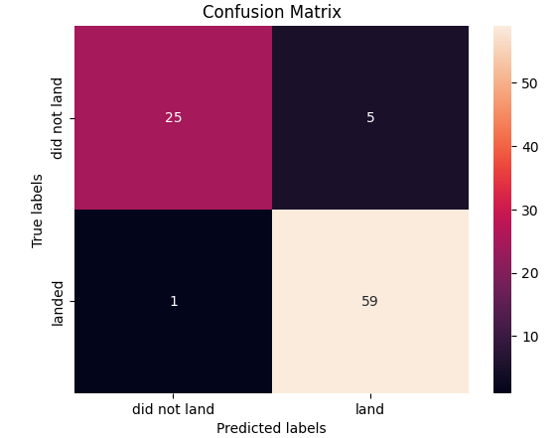
Confusion Matrix
The confusion matrix for the Decision Tree model (tested on all data) had the highest true positive classification rate (precision of 98%)
This model also correctly labeled the most successful launch outcomes (recall of 92%)

Slide 44
Conclusions
SpaceX data was collected and exploratory data analysis conducted to determine which launch features had the most impact on successful landings
Successful Falcon 9 landings are influenced by launch site, payload mass carried, flight number (examining landing outcomes over time), rocket and orbit features
Visualizations showed the impact of payload mass, flight number, rocket booster type, orbit type and launch site on successful landings
Using the identified launch features, 4 classification models were trained on predicting successful landings
Decision Trees appears to be the most precise model, as well as having the most accurate recall, for determining whether a Falcon 9 landing is successful
Decision Trees therefore should be used to accurately forecast potential cost savings on Falcon 9 landings

Slide 45


